Slide 1
A Glove-based System for Studying Hand-Object Manipulation via Pose and Force Sensing
Hangxin Liu*, Xu Xie*, Matt Millar*, Mark Edmonds, Feng Gao, Yixin Zhu, Song-Chun Zhu UCLA Center for Vision, Cognition, Learning, and Autonomy Veronica J. Santos
UCLA Biomechatronics Lab
Brandon Rothrock Jet Propulsion Laboratory

Slide 2
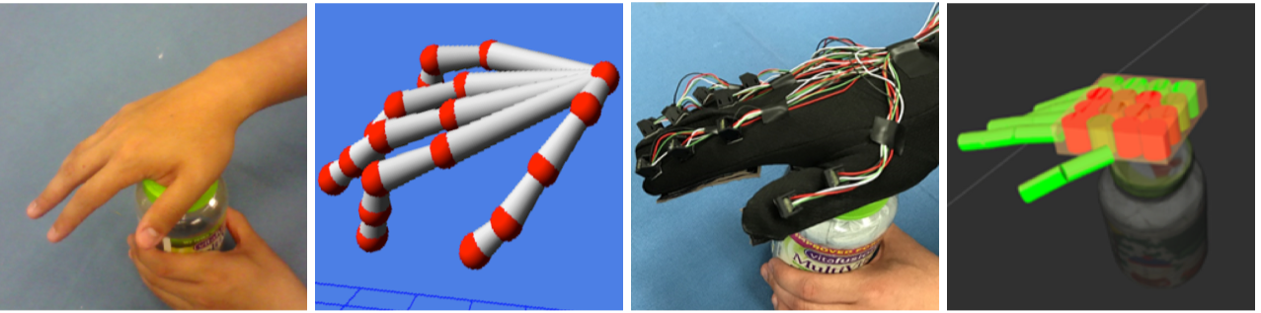
Background and Objectives
Objectives
Outline
Background and Objectives
Overall System Design
Sensing Approaches
Experimental Evaluation
IMUs
Velostat sensors
System
Conclusions and Future Work
Develop an easy-to-replicate glove-based system that performs hand pose
and force sensing.
Evaluate the performance of the proposed design.
Related work
Pose sensing with IMUs (Taylor etal. 2013), some incooperate with EKF filtering (Santaera etal. 2015)
Force sensing with liquid-metal (Hammond etal. 2014) and FlexiForce (Gu etal. 2015)

Slide 3
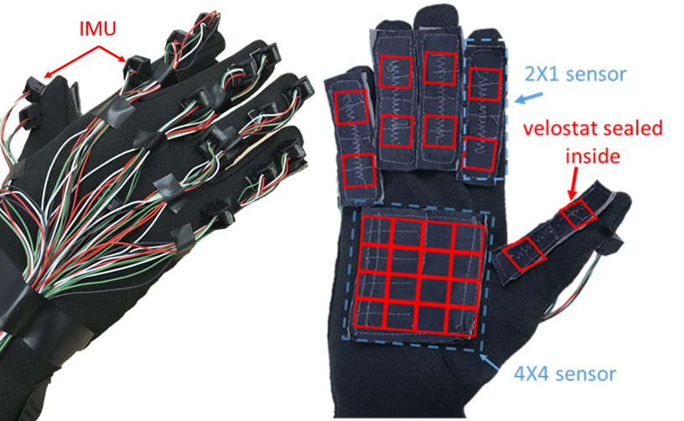
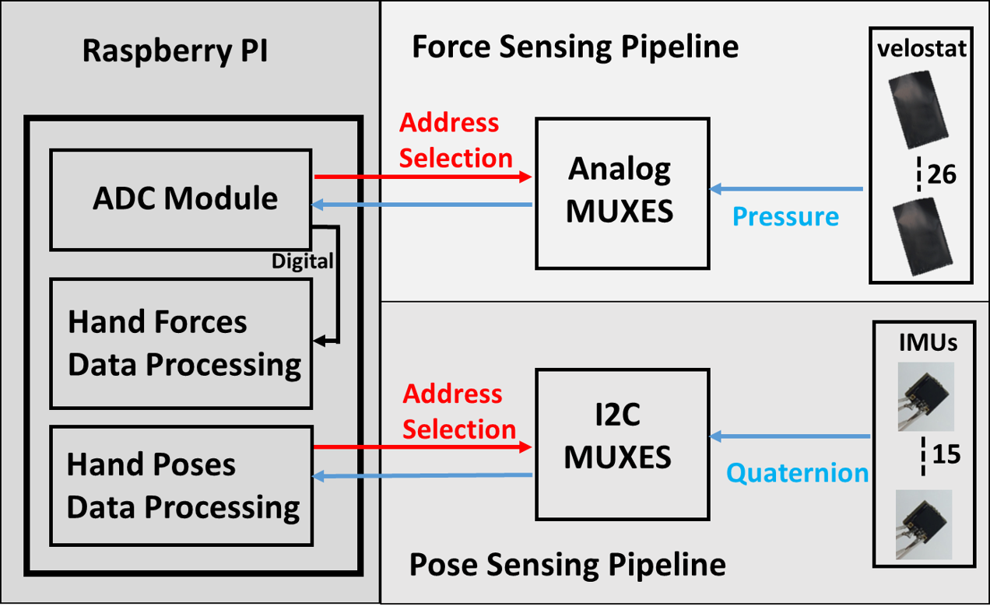
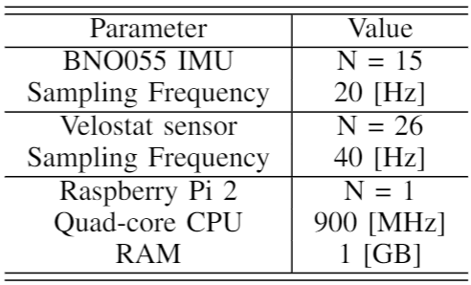
Overall System Design & Prototyping
Overall System schematic:
Pose sensing: 15 IMUs
Force sensing: 6 Velostat sensors with 26 taxels
Prototype:
Outline
Background and Objectives
Overall System Design
Sensing Approaches
Experimental Evaluation
IMUs
Velostat sensors
System
Conclusions and Future Work
2.72 W total power consumption

Slide 4
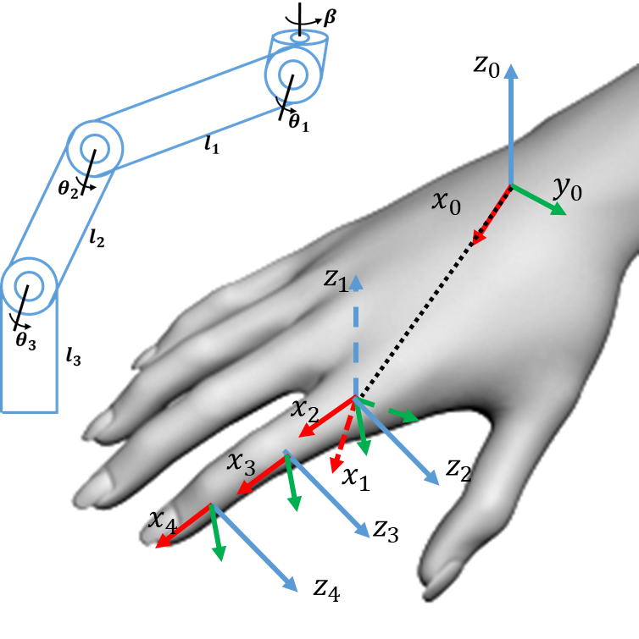
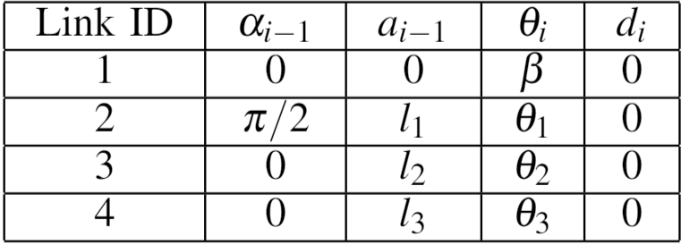
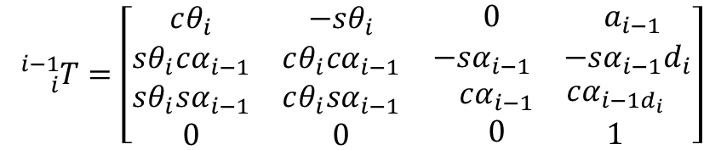
Sensing Approaches - Pose
Finger joint angle is sensed via two IMUs
Hand pose is reconstructed using forward kinematics
Outline
Background and Objectives
Overall System Design
Sensing Approaches
Experimental Evaluation
IMUs
Velostat sensors
System
Conclusions and Future Work
DH parameters for a finger:
Homogeneous transformation:
$${}_{i}^{i−1}{T=\left[\begin{matrix}cθ_{i} & −sθ_{i} & \begin{matrix}0 & a_{i−1}\end{matrix} \\ sθ_{i}cα_{i−1} & cθ_{i}cα_{i−1} & \begin{matrix}−sα_{i−1} & −sα_{i−1}d_{i}\end{matrix} \\ \begin{matrix}sθ_{i}sα_{i−1} \\ 0\end{matrix} & \begin{matrix}cθ_{i}sα_{i−1} \\ 0\end{matrix} & \begin{matrix}\begin{matrix}cα_{i−1} \\ 0\end{matrix} & \begin{matrix}cα_{i−1d_{i}} \\ 1\end{matrix}\end{matrix}\end{matrix}\right]}$$

Slide 5
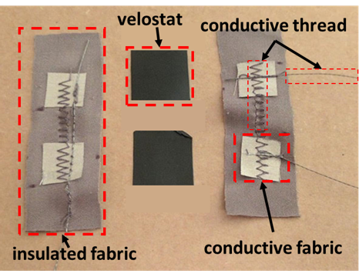
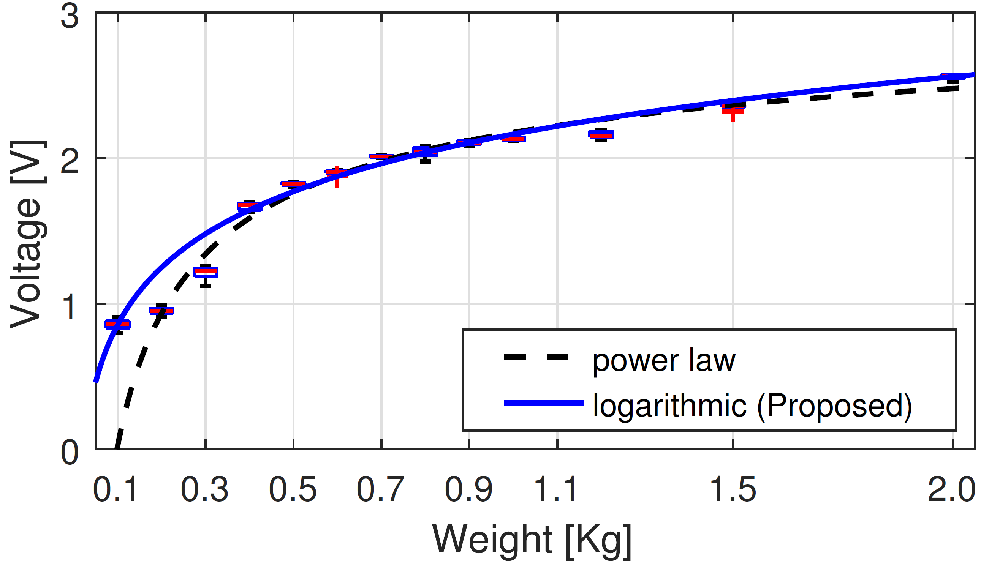
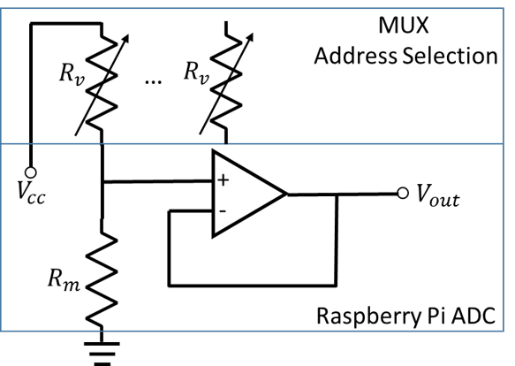
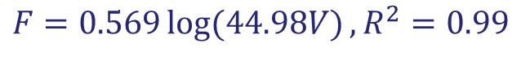
Sensing Approach - Force
Force sensors are made from Velostat, a soft piezoresistive material.
Outline
Background and Objectives
Overall System Design
Sensing Approaches
Experimental Evaluation
IMUs
Velostat sensors
System
Conclusions and Future Work
Multi-layers structure
Force-Voltage Relation of the force sensor:
$$F=0.569\log{(44.98V)},R^{2}=0.99$$
Sensor circuit

Slide 6
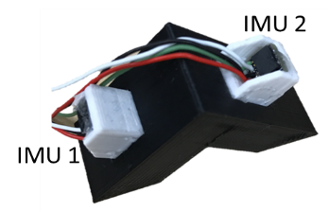
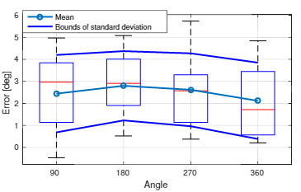
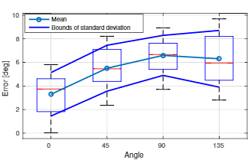
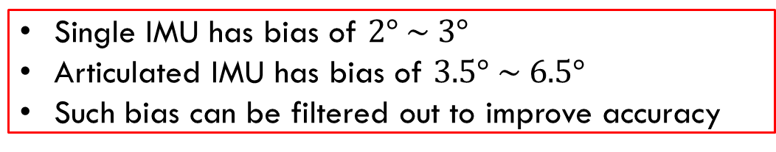
Evaluation of IMUs
Outline
Background and Objectives
Overall System Design
Sensing Approaches
Experimental Evaluation
IMUs
Velostat sensors
System
Conclusions and Future Work
Single IMU Evaluation:
Articulated IMU Evaluation:
Single IMU has bias of $2° \sim 3°$
Articulated IMU has bias of $3.5° \sim 6.5°$
Such bias can be filtered out to improve accuracy

Slide 7
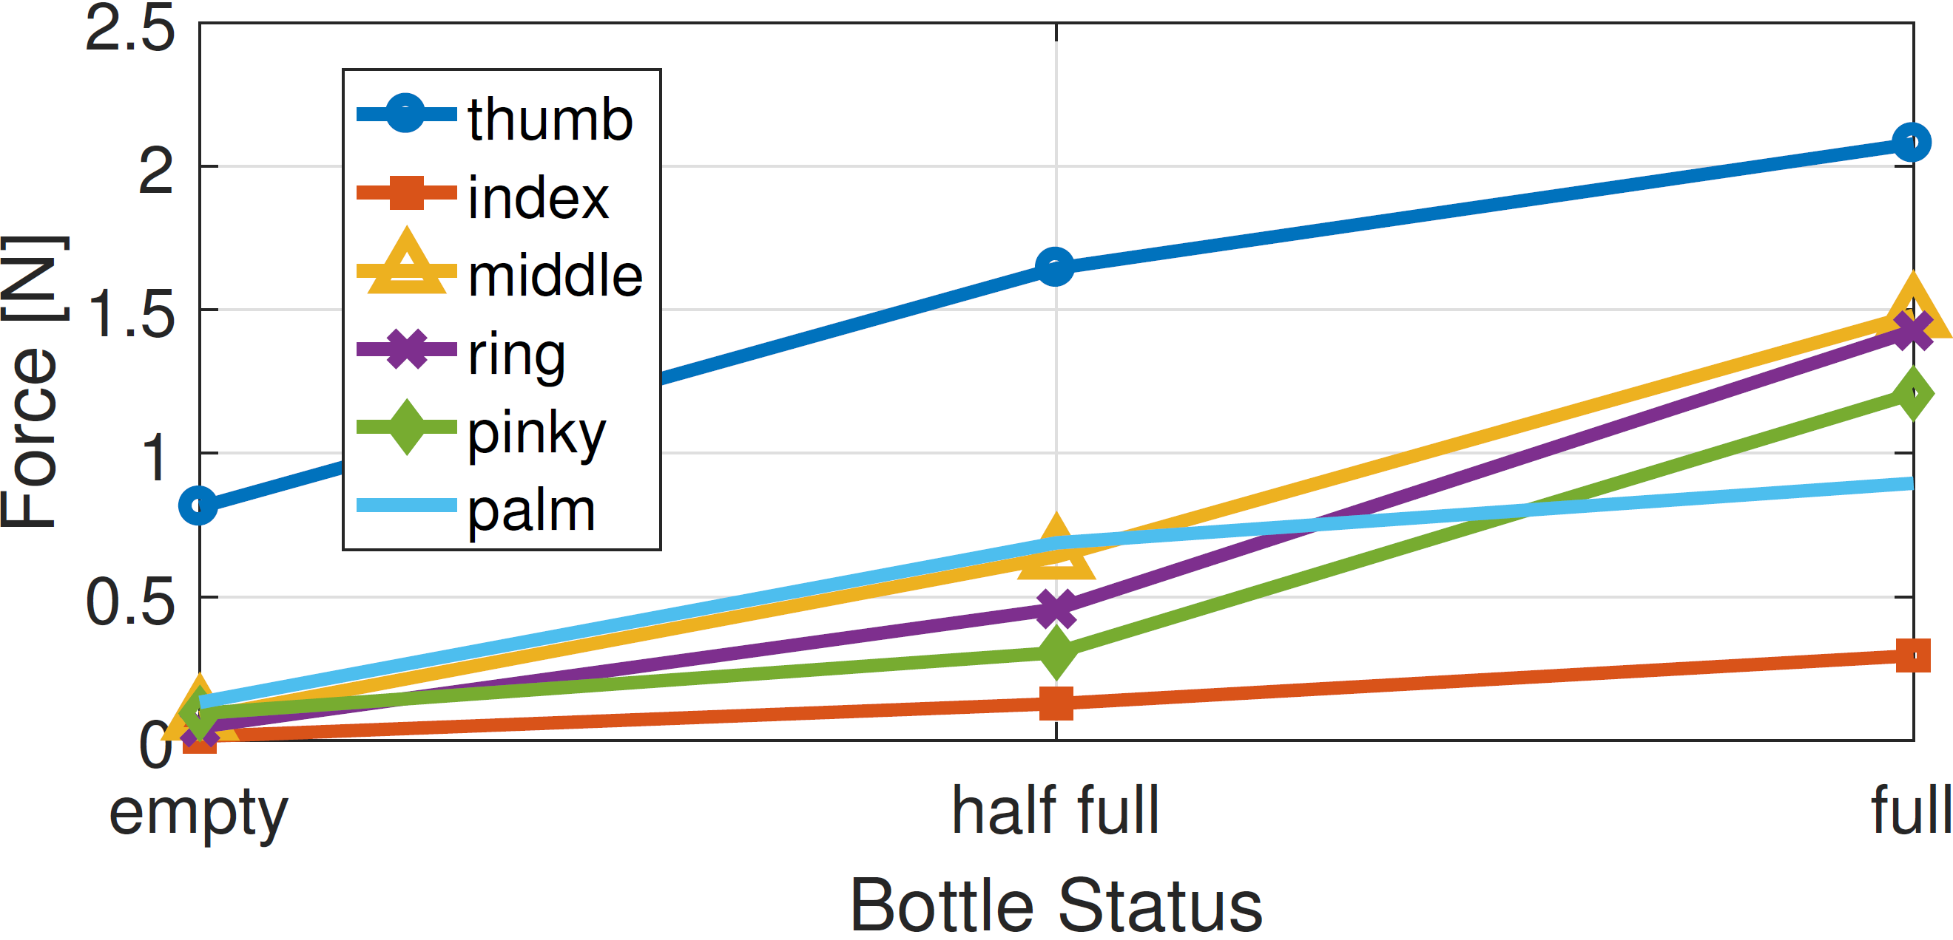
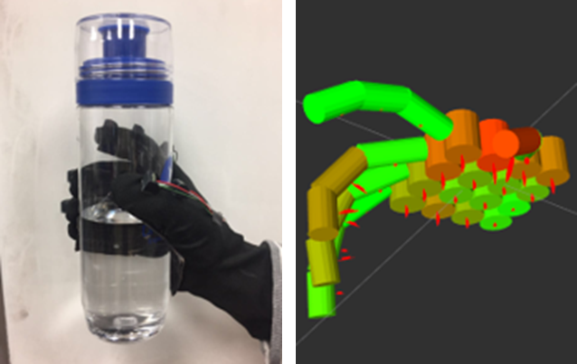
Evaluation of Velostat Sensors
Outline
Background and Objectives
Overall System Design
Sensing Approaches
Experimental Evaluation
IMUs
Velostat sensors
System
Conclusions and Future Work
Average force reading in each region
Grasping pose:
Force Vector:
0.46Kg
0.13Kg
0.73Kg
Response increases as bottle weights increase.
Force is qualitatively evaluated.
Combine force and pose into a homogeneous representation: force vector.

Slide 8
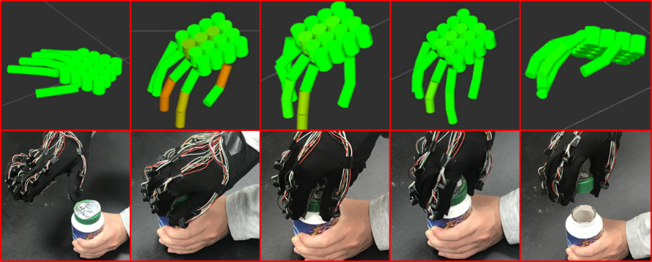
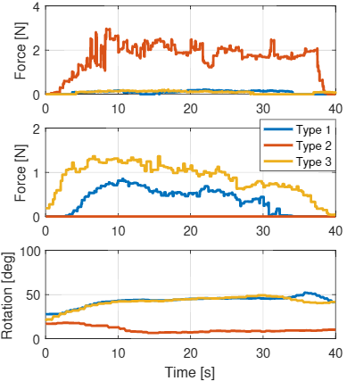
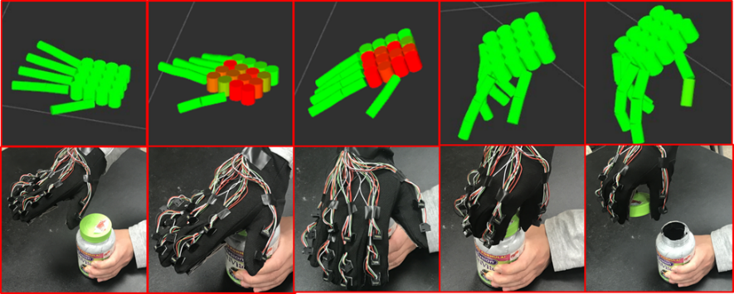
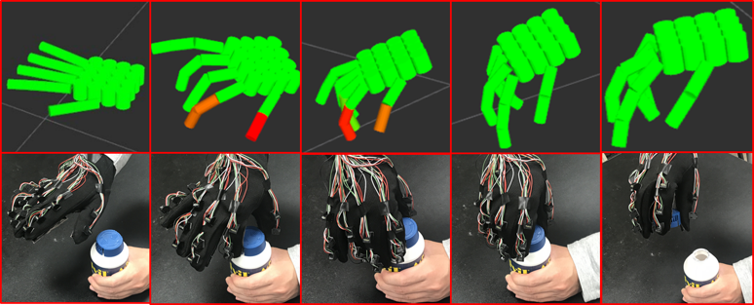
System Evaluations
No lock
Force at Palm
Outline
Background and Objectives
Overall System Design
Sensing Approaches
Experimental Evaluation
IMUs
Velostat sensors
System
Conclusions and Future Work
low force in palm
medium force in thumb
bended index finger
Type 1
Press
Force at Thumb tip
high force in palm
low force in thumb
Stretched index finger
Type 2
Pinch
Rotation of joint of index finger
low force in palm
high force in thumb
bended index finger
Type 3

Slide 9
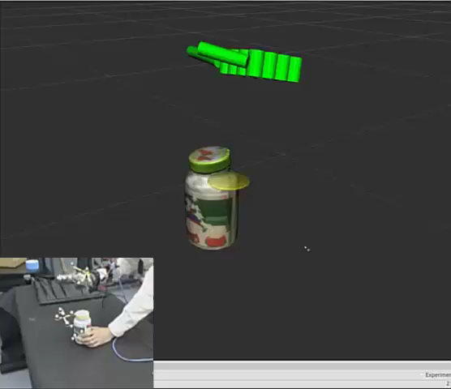
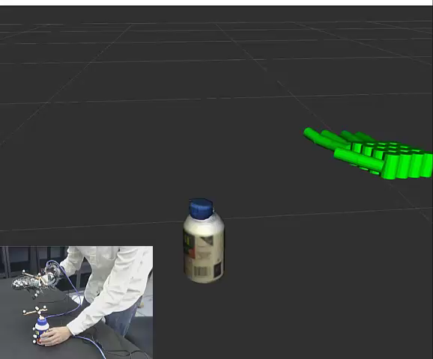
System Evaluations
Type 2: press
Type 3: pinch
Outline
Background and Objectives
Overall System Design
Sensing Approaches
Experimental Evaluation
IMUs
Velostat sensors
System
Conclusions and Future Work
The acquired data are used to teach robot opening medicine bottles.
(Edmonds et al., Opening Medicine Bottles: Discovering Hidden Fluents through Imitation Learning, IROS 2017)

Slide 10
Conclusion and Future Work
Outline
Background and Objectives
Overall System Design
Sensing Approaches
Experimental Evaluation
IMUs
Velostat sensors
System
Conclusions and Future Work
Conclusions
Use IMUs and Velostat for pose and force sensing.
Integrated system with open-source (ROS) framework.
Capability of characterizing manipulative actions.
Future Work
Improving the visualization and the fabrication.
Applications in VR/AR.
Acknowledgement: DARPA SIMPLEX and ONR MURI

